Slide 1
From disk drives to cloud storage
Dr. Ping Huang
Principal Engineering at OCI

Slide 2
Agenda
Behind the Cloud Storage
Disk Technology Basics
NPI Disks to the Cloud
Sustaining Disk Based Storage Systems
EOL Disk Drives
Cloud Storage
Concept and definition
Cloud Storage Architecture
Storage Virtualization

Slide 3
Disk Technology Basics
What is common among the EC2, EFS, EBS, S3?

Slide 4
Disk Technology Basics
What is common among the EC2, EFS, EBS, S3?
Storage Media
Storage Media be categorized based on
Media Technology: Hard Disk Drive (HDD) and Solid State Drive (SSD)
Interface to Host: SATA , SAS, NVMe

Slide 5

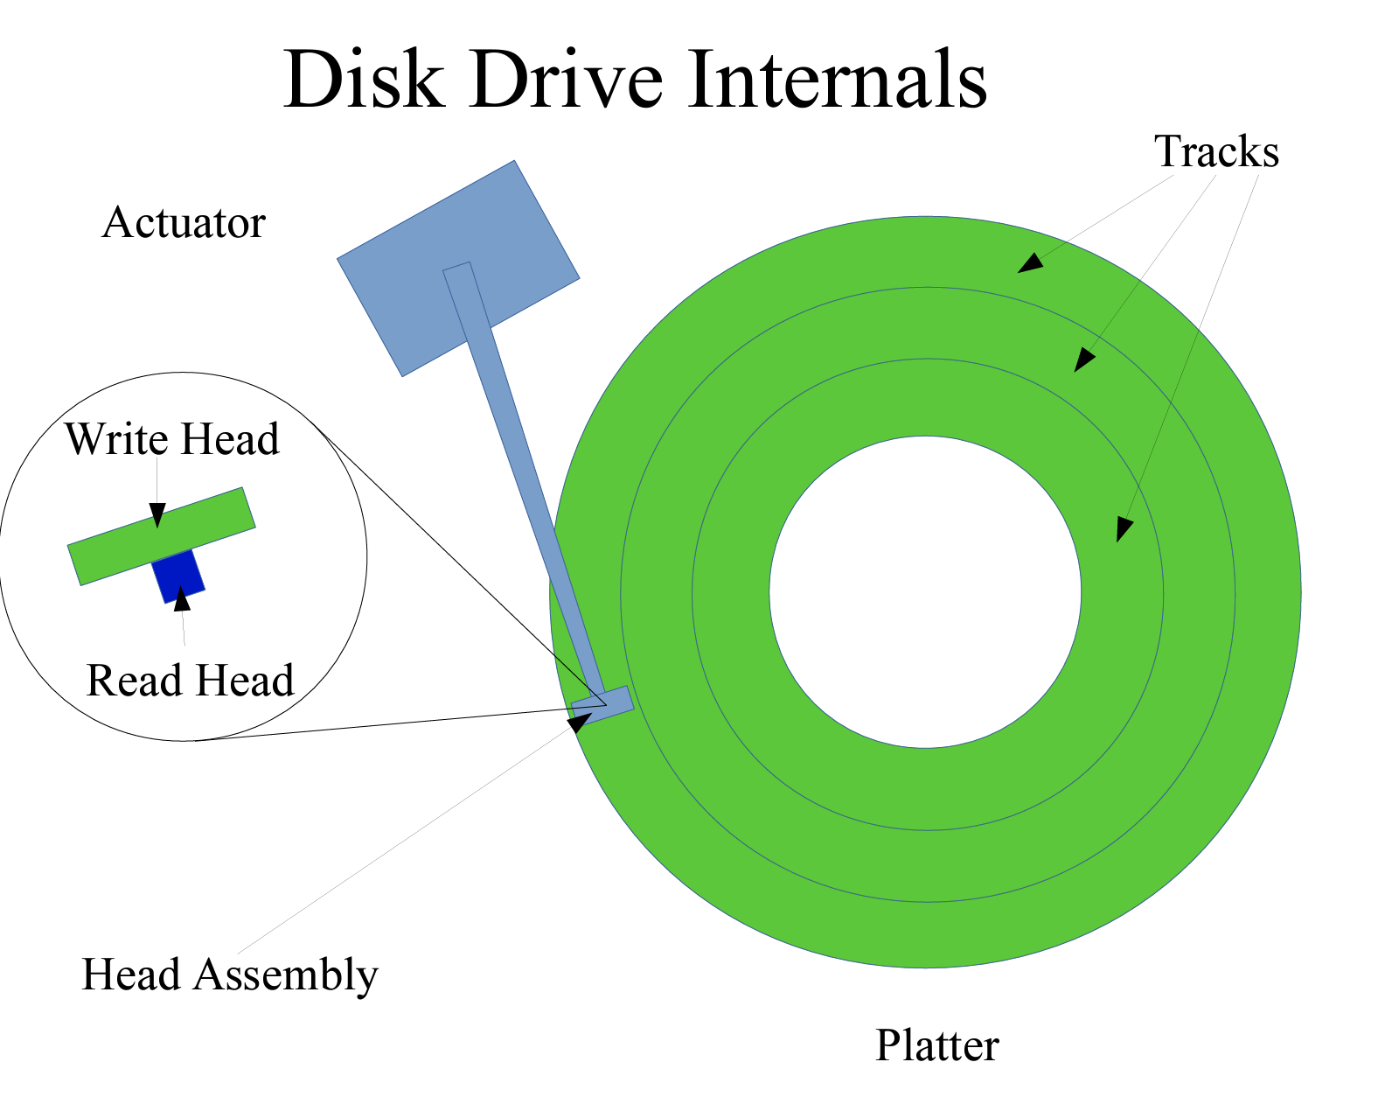

HDD Characteristics
Based on Magnetic Theory
Multiple Disk Heads corresponding to disk platters
Mechanical Actuators to drive Disk Heads
Servo System to help position heads, i.e., called seeking
Disk platters are spinning while the disk is seeking
Data is organized as Sectors on the disk tracks
Shingle Magnetic Recording (SMR) HDD improves capacity
Poor random performance, but good sequential performance
Cheap $/GB, 25T/26T per drive

Slide 6
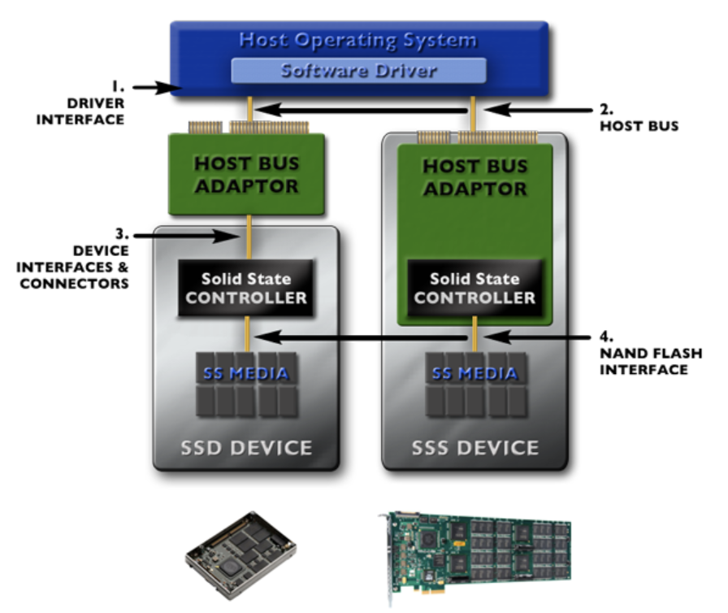
SSD Characteristics
Mainly Based on NAND Flash Memory, SLC, MLC, TLC, QLC
Read, Write/Program, Erase operations, in page and block units
Overprovisioning Space to make an SSD workable
Flash Translation Layer (FTL) to mask these idiosyncrasies
Garbage Collection (GC) to reclaim space
High performance and lower power consumption
Limited lifespan in P/E cycles

Slide 7
NPI disks to The Cloud
Hyper-scale customers have different requirements than other market segments
Unique operating environments, i.e., managed data centers
Large volume of buy-in, allowing customization
Performance, reliability, energy-efficiency
Typically, long-term partnership
Customers:
AWS, Azure, GCP, Meta Platform, Apple, Tiktok
SSD OEMs:
Samsung, Sk Hynix, Intel(Solidigm), Micron, Western Digital, Toshiba
Server ODMs Providing EMS:
Foxconn, Quanta

Slide 8
Roles of the parties during NPI
Customers
Plan on the projects
Define project requirements: performance, durability, thermal spec, etc.
Communicate requirements to OEMs
Instruct ODMs on building and testing servers
Coordinate collaboration between OEMs and ODMs
SSD OEMs
Propose new SSD products/features to customers
Align with customers on technical roadmap, e.g., quarterly
Address customer requirements
Conduct adequate in-house testing

Slide 9
Roles of the parties during NPI
Customer
ODM
OEM
Server ODM:
Plan on resources for customers’ projects
Perform the tests per customers’ request
Provide test reporting to customers
Monitor progress is on schedule
Track issues encountered during the testing
Work with both OEM and Customer to address issues

Slide 10
Roles of the parties during NPI
Customer
ODM
OEM
Server ODM:
Plan on resources for customers’ projects
Perform the tests per customers’ request
Provide test reporting to customers
Monitor progress is on schedule
Track issues encountered during the testing
Work with both OEM and Customer to address issues
Disk drives are qualified for the specific project !! Congrats!

Slide 11
In the field
Drives are constantly failing or malfunctioning
Drives become slow
Data inconsistency
Drive dropping
Drive hung
Various reasons
Software bugs
Human incidents, e.g., misconfiguration
Firmware bugs
Hardware breakdown
Thermal violation

Slide 12
monitoring
S.M.A.R.T Technology
Self-Monitoring, Analysis, Reporting, Technology Attributes
These attributes are indicative of the drive’s health
Each server runs an agent which periodically collects and sends SMART a database
Dashboard
Host of SMART attributes
Visualization for easy check of trends
Data Analysis and Machine Learning to gain insights from the data
Fleet Management
Instance migration
Storage migration
Server isolation
Firmware update

Slide 13




SMART
Dashboard
SMART
.
.
.
SMART
Migration/ Isolation
Servers
Fleet Management

Slide 14
EOL Disk Drives
When the server reaches end of service life
Retire the server and disk components
Ensure data is not subject to leakage
Data Eradication Process
Software approach
Disk cleaning via security erase and data sanitization
Media Destruction Process
Physical approach
Destroy the drives

Slide 15
Cloud Storage
What is Cloud Storage ?
Cloud Storage refers to the practice of storing digital data on remote servers, typically managed by third-party providers, rather than on locally. It allows individuals and organizations to save their files on servers maintained by cloud service providers and access their data from any internet-connected device, at any time, and from virtually anywhere in the world.
Cloud Storage can be characterized by: Remote Data Storage, Accessibility, Scalability, Security, Cost-effectiveness
Types of Cloud Storage: Personal Cloud Storage, Enterprise Cloud Storage, Hybrid Cloud Storage
Cloud Storage Providers: Amazon AWS, Google GCP, Microsoft Azure, Oracle OCI
Cloud Storage Interfaces: Object-Storage, Block Storage, File Storage

Slide 16
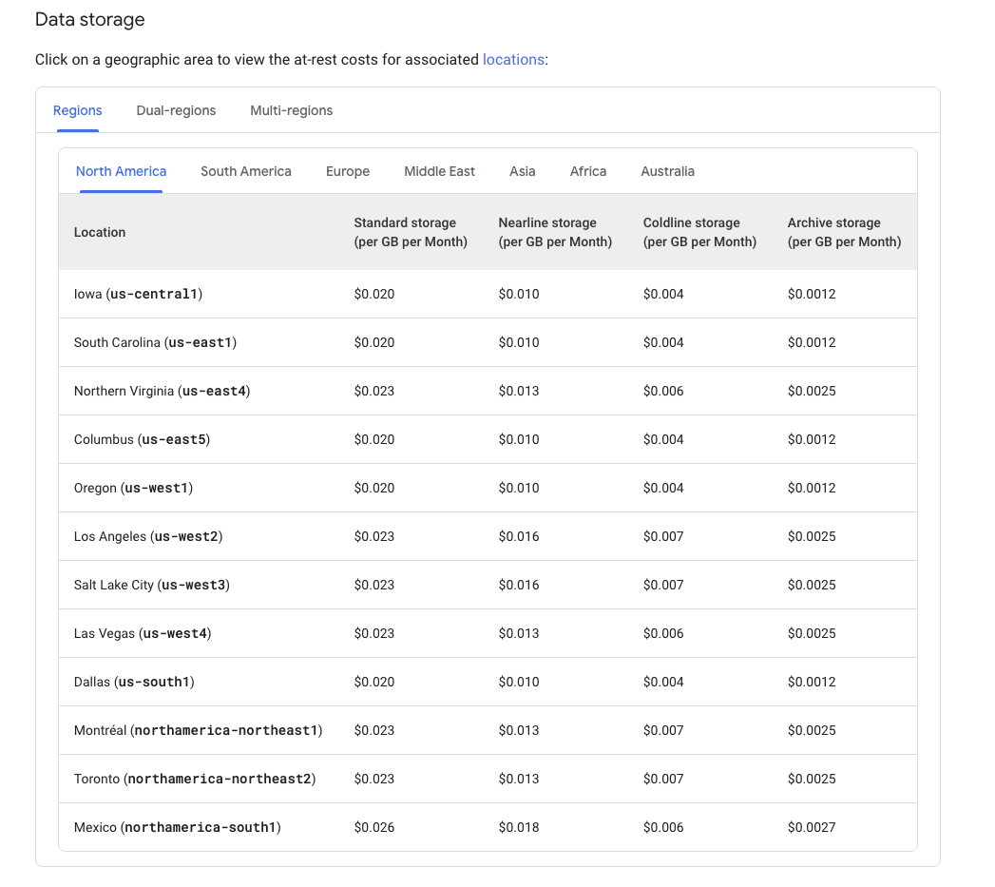
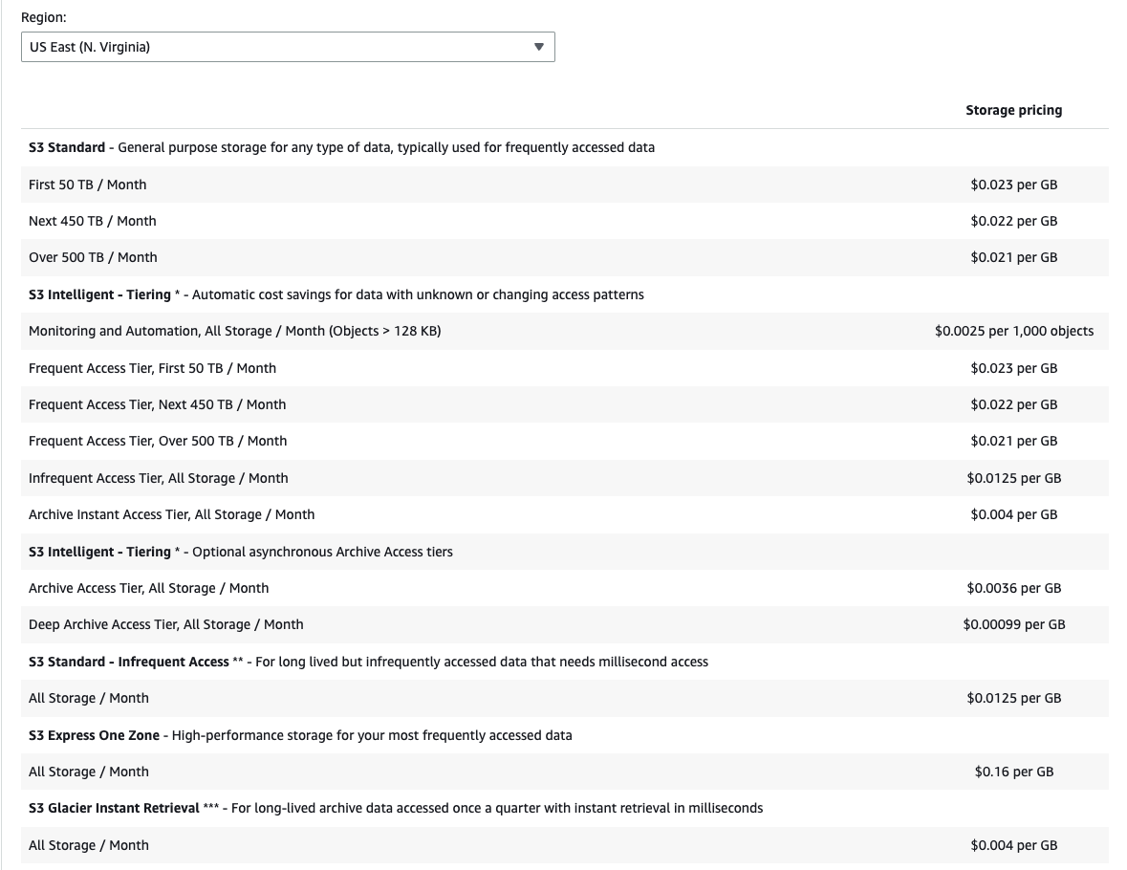
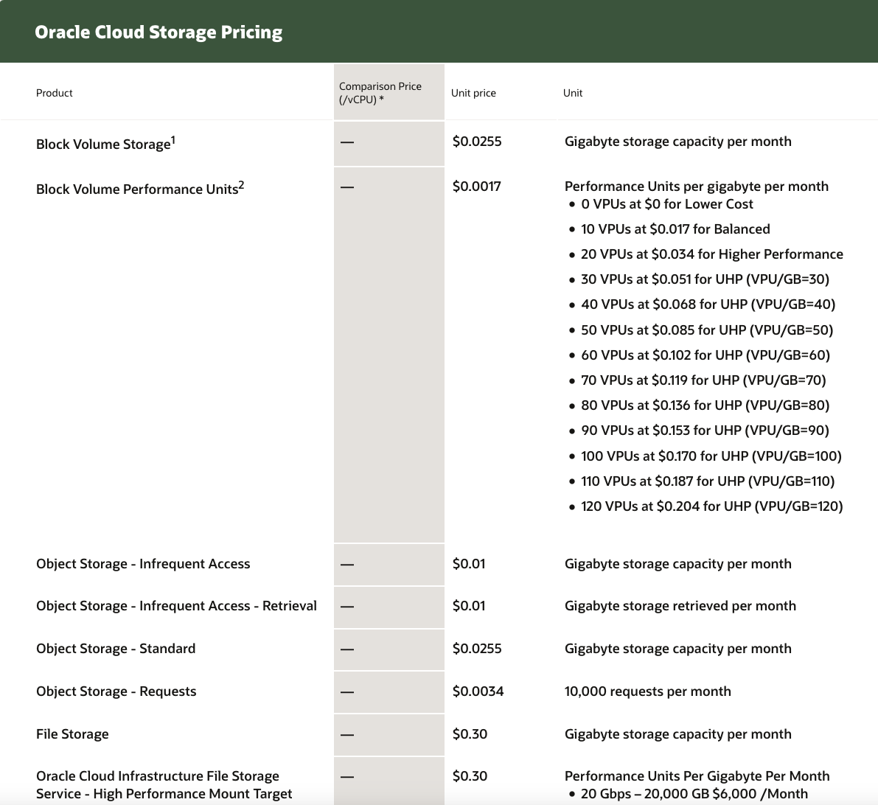
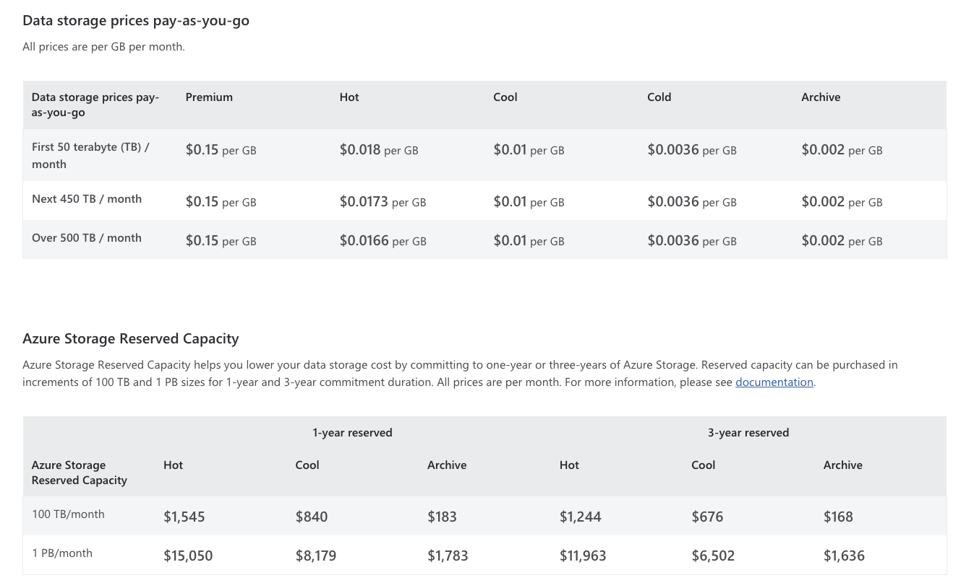
Cloud Storage offerings
GCP
AWS
OCI
Azure

Slide 17
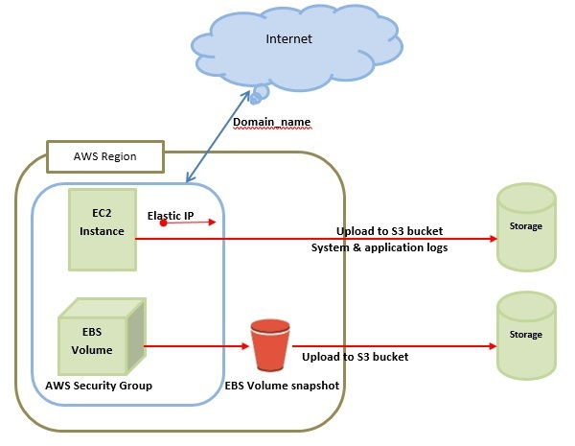

Architectural Overview

Slide 18
Cloud storage virtualization
Cloud storage virtualization is the process of abstracting and pooling physical storage resources across multiple servers or locations into a unified, logical storage system. This allows users and applications to access storage resources as though they were a single, unified entity, even though the underlying storage infrastructure may be distributed, heterogeneous, and geographically dispersed.
Key Concepts of Cloud Storage Virtualization
Abstraction Layer
Pooling of Resources
Provisioning and Management
Flexibility and Scalability

Slide 19
Thanks !

